Slide 1

Green Pace
Security Policy Presentation
Developer: Evan Nagy

Slide 2

OVERVIEW: DEFENSE IN DEPTH
The purpose of this security policy is to set a collection of standards and best practices to maintain the safety of our software and data. The different parts of this policy make up some of the layers of defense in depth strategy.

Slide 3
THREATS MATRIX
Low Priority: unlikely to happen with a low severity
Likely: probable or likely to happen with a low severity
Unlikely: unlikely to happen but with a high severity.
Priority: probable or likely to happen with a high severity.
Likely STD-002-CPP STD-007-CPP | Priority STD-004-CPP STD-005-CPP
Low priority STD-001-CPP STD-006-CPP STD-009-CPP STD-010-CPP | Unlikely STD-003-CPP STD-008-CPP

Slide 4
10 PRINCIPLES
Validate Input Data – STD-004-CPP
Heed compiler Warnings – STD-001-CPP, STD-002-CPP
Architect and design for Security Policies – STD-006-CPP, STD-007-CPP,STD-008-CPP
Keep It Simple - STD-002-CPP, STD-004-CPP, STD-008-CPP, STD-010-CPP
Default Deny - STD-009-CPP
Adhere to Principle of Least Privilege – STD-009-CPP
Sanitize Data Sent to Other Systems
Practice Defense in Depth - STD-005-CPP
Use effective Quality Assurance Techniques - STD-003-CPP, STD-005-CPP, STD-007-CPP,
Adopt Secure Coding Standard - STD-003-CPP, STD-008-CPP, STD-010-CPP

Slide 5
CODING STANDARDS In Order of Priority
STD-004-CPP - Sanitize data passed to complex subsystems
STD-005-CPP – properly deallocate dynamically allocated resources.
STD-003-CPP – Range check element access
STD-008-CPP – Do not modify the standard namespaces
STD-002-CPP – Value-returning functions must return a value from all exit paths
STD-007-CPP – handle all exceptions
STD-001-CPP – Never qualify a reference type with const or volatile
STD-006-CPP – understand the termination behavior of assert() and abort()
STD-009-CPP – close files when they are no longer needed
STD-010-CPP – write constructor member initializers in canonical order.

Slide 6
ENCRYPTION POLICIES
Encryption at rest
 | Encryption at rest refers to data being in an encrypted state while it is in storage. This means that even if access to the data is gained, the data itself is unreadable unless you have the key to decrypt it. This policy should be used so that if data was taken, the information within would still be safe and could not be read without the key.
Encryption at flight | Encryption at flight refers to data being in an encrypted state while it is transit from one place to another. While data is in route, it must be encrypted. This ensures that if the data is intercepted, the information within the data would be safe because it cannot be read without the key.
Encryption in use | Encryption in use refers to the encryption of data as it is being used by the system. It is used to keep data secure at all times, even as it is changing. This allows the data to be secured with encryption at rest ,in transit and in use leaving out all possible weak links from t he system.

Slide 7
TRIPLE-A POLICIES
Authentication | Authentication is the process of confirming that a user is who they say they are. It is typically used when adding new users or when a user attempts to login. This policy applies whenever a user is attempting to gain access to a system or something within a system. You need to make sure that the person using our system is who you expect them to be. This is typically ensured by username and password verification.
Authorization | Authorization is the process of confirming that a user is supposed to have access to what they are requesting. It determines the level of access a user has within the system. This policy applies to whenever a user is attempting to access something within the system. Once authenticated, authorization should determine if the user can gain entry to the system. This helps user keep out of places they shouldn’t be in.
Accounting | Accounting is the process of tracking and logging all requests and transactions made by a user. Examples of that would be changs made to a database or file accessed by a user. This policy allows you to know what is happening within a system.

Slide 8
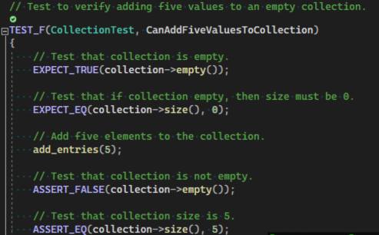
Unit Testing CanAddFiveValuesToCollection

Slide 9
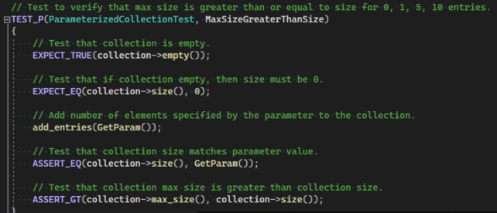
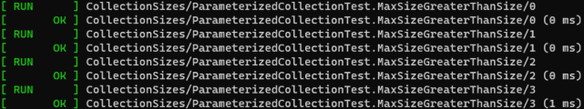
Unit Testing MaxSizeGreaterThanSize

Slide 10
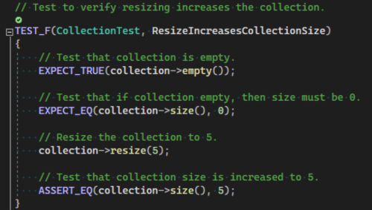
Unit Testing ResizeIncreasesCollectionSize

Slide 11
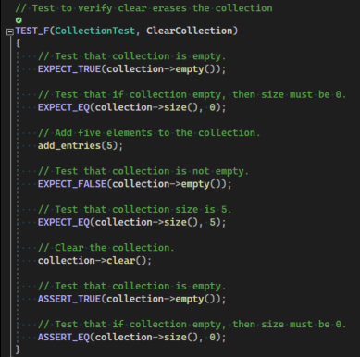
Unit Testing ClearCollection

Slide 12

AUTOMATION SUMMARY
DevSecOps can help to ensure you are creating the most secure application possible and automation can help with this process
The policies and standards set within this security policy document should be utilized during the DevSecOps process

Slide 13
TOOLS
The DevSecOps pipeline shows the flow the development process goes through
Pre-production: step to design and test the software
Production: steps for deploying, monitoring, and maintaining the software.
Design stage – owsap or security policy for creating a secure design.
Build stage – ide/compiler for compiling and running the code
Verify and test stage – static analysis and unit testing tools
Monitor and detect stage – logging and application monitoring tools

Slide 14
RISKS AND BENEFITS
When should security be implemented in the Software Development Lifecycle?
It should be implemented immediately
Security of your application and data is serious and must be treated that way
Security should be thought of as planning begins.
Benefits
Easier to implement security when planned from the start
More robust/reliable code
More consistent code
Risks
Not enough buy-in
Application breached and data exposed if taking a wait and see approach

Slide 15
RECOMMENDATIONS
A security policy does no good if it is not understood and followed
DevSecOps training for developers
Automated monitoring of software dependencies for vulnerabilities and patches to prevent supply chain attacks.

Slide 16
CONCLUSIONS
Security must be considered from the beginning
Training must be provided on security and security policies
Enforcement mechanisms should be in place to ensure the security policy if followed.
Deployment of an application should not be possible if the security policy requirement is not met
The security policy should be regularly reviewed and updated where needed.

Slide 17
REFERENCES
Digital Security Best Practices. Microsoft Security Blog. (2026, March 31). https://www.microsoft.com/en-us/security/blog/content-type/best-practices/
Sei cert C++ coding standard. SEI CERT C++ Coding Standard | CERT Secure Coding. (n.d.-a). https://cmu-sei.github.io/secure-coding-standards/sei-cert-cpp-coding-standard

